Slide 1
Change the story

Slide 2
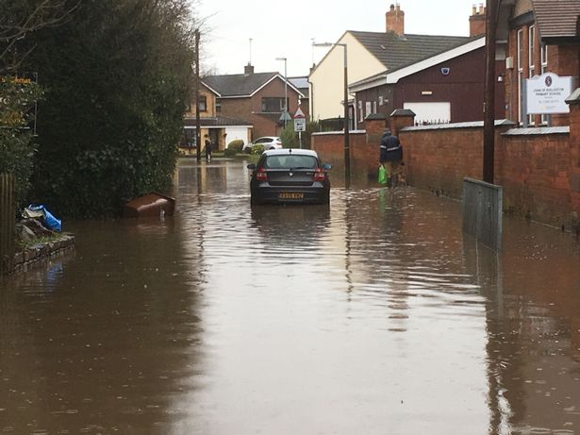
The Problem
Houses are flooding more frequently and houses are being
ruined .

Slide 3
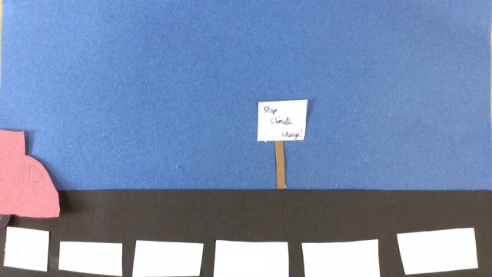
Watch this video to find out more

Slide 4
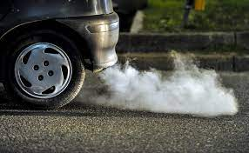
The cause
We are burning too many fossil fuels which is bad for the environment. Use less electricity.

Slide 5
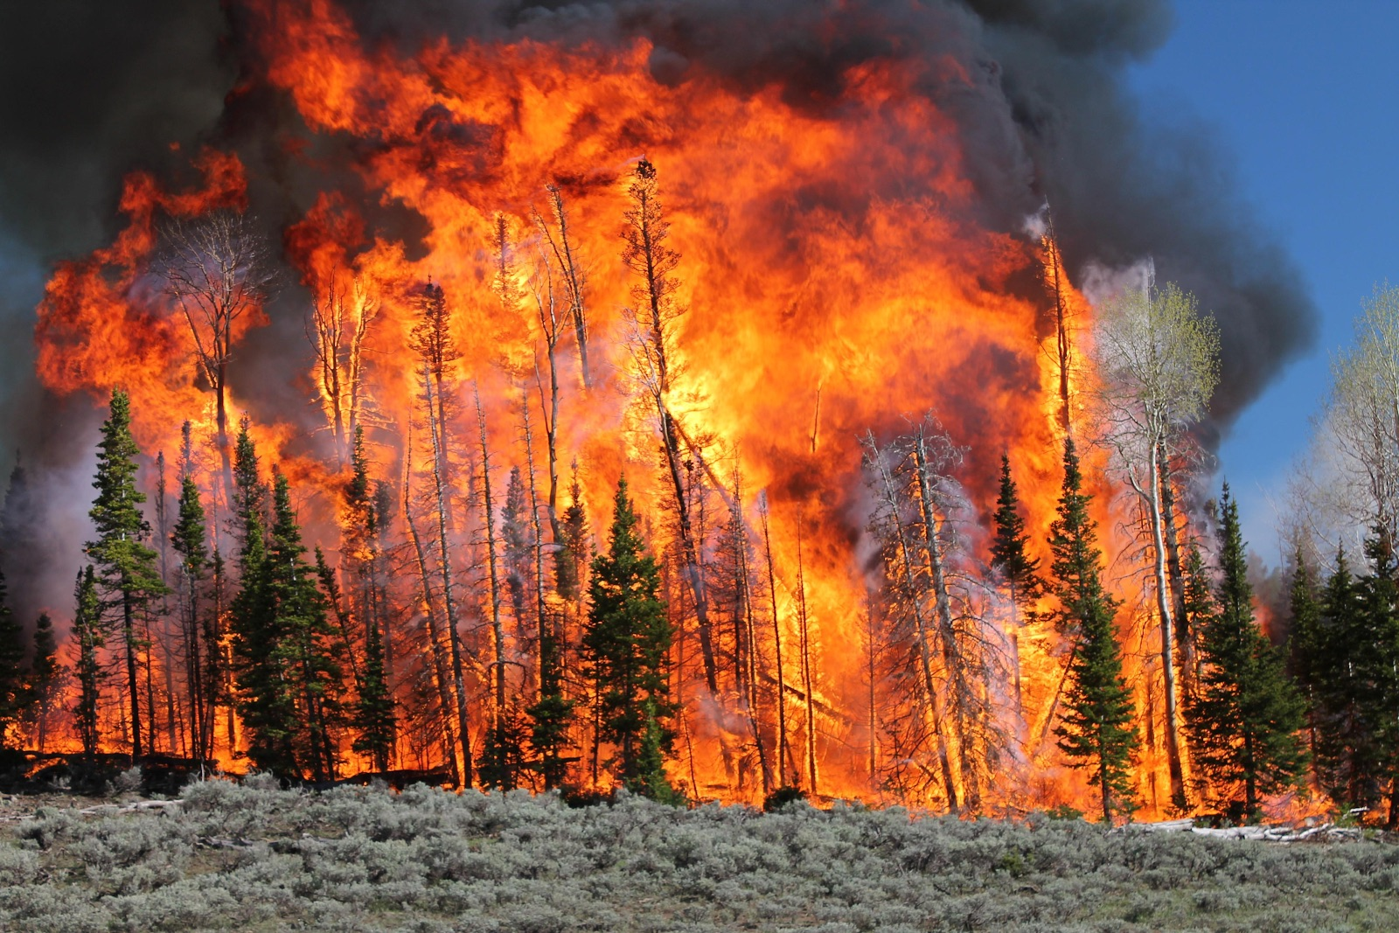
Consequences
Crop failure is happening because of extreme weather
Ice caps melting
Animals become extinct because they have no home
Forest fires
Flooding
Land underwater - sea level rise
Storms and severe weather

Slide 6

The solution
Consume less
Use solar panels and less electricity
Eat less meat
Have an electric car powered by renewable energy
Insulate houses to keep the heat in
Walk and cycle more so you are not burning as much fossil fuels
Conserve electricity

